Slide 1
G H Raisoni College of Engineering & Management, Pune
(An Empowered Autonomous Institute Affiliated to Savitribai Phule Pune University)
Department of Information Technology
Title: "MicroAPI Guard"
AI-Based Anomaly Detection System for API Traffic
in Microservice Architectures
Project Review I
Presented by:
1) _________________________ [BTech IT]
2) _________________________ [BTech IT]
3) _________________________ [BTech IT]
Guided By:
[Guide Name]
raisoni
EDUCATION
Nagpur | Pune | Jalgaon | Amravati | Pandhurna | Bhandara

Slide 2
Introduction
Modern applications are built using Microservice Architecture — small, independent services communicating via APIs.
APIs handle millions of requests daily (login, data fetch, payments, notifications) and represent the #1 attack surface in modern systems.
Common API attacks include brute force, DDoS, scraping, and credential stuffing.
Traditional defense: Static Rate Limiting — fixed rules like "block after 100 requests/min".
Problem: Static rules cannot adapt to evolving attack patterns. They either allow sophisticated abuse to pass through or block legitimate traffic spikes.
Solution: MicroAPI Guard — an unsupervised anomaly detection system that learns normal API traffic behavior and flags deviations in real-time, without requiring labeled attack data.

Slide 3
Problem Statement
Traditional API rate-limiting and monitoring tools rely on static thresholds (e.g., "block after 100 requests/minute"), which cannot adapt to evolving traffic patterns.
They either allow sophisticated abuse to pass through or block legitimate traffic spikes — resulting in high false positive rates.
This project proposes an unsupervised anomaly detection system that learns normal API traffic behavior and flags deviations in real-time, without requiring labeled attack data.
Key Issues with Static Rate Limiting:
Same rule for all users — no adaptability
Legitimate users get blocked during traffic spikes
Smart attackers bypass by staying just under the limit
No learning from traffic patterns over time
High false positive rate (~18% as per Patel & Sharma, 2023)

Slide 4
Existing System vs Proposed System
Feature | Existing System (Static Rate Limiter) | Proposed System (MicroAPI Guard)
Detection Method | Fixed threshold (e.g., 100 req/min) | ML-based pattern learning
Adaptability | None | Learns and adapts over time
Smart Attack Defense | Bypassable (stay under limit) | Detects pattern anomalies
False Positive Rate | High (~18%) | Low (~4%)
Labeled Data Needed | N/A | No (unsupervised)
Real-time Alerts | No | WebSocket live push

Slide 5
Literature Survey
# | Author(s) | Year | Methodology | Limitation / Gap
1 | Liu et al. | 2020 | Isolation Forest on network traffic (UNSW-NB15 dataset) | Not API-specific
2 | Ahmed & Khan | 2021 | IF on REST API logs (91% precision) | Single model, no comparison
3 | Zhang & Wang | 2022 | Autoencoder for HTTP traffic (96.2% accuracy, CICIDS2017) | Single model, no API deployment
4 | Kumar & Reddy | 2022 | Survey of 40+ papers on API anomaly detection features | No implementation
5 | Patel & Sharma | 2023 | Static vs ML comparison (18% vs 4% FPR) | Generic ML, not IF vs AE specific
6 | Sowmya M. et al. | 2023 | API-TAD: ML for API anomaly detection (IEEE CCGridW) | No model comparison study
7 | CNN-AE Hybrid | 2024 | AE detects + CNN classifies anomaly types | Complex architecture
8 | GCN-LSTM-AE | 2024 | Graph + temporal anomaly detection in microservices | Heavy infrastructure needed

Slide 6
Literature Survey (Continued)
# | Author(s) | Year | Methodology | Limitation / Gap
9 | IEEE IJCNN | 2024 | Optimizing AE for network anomaly detection | No microservice context
10 | ML Comparison | 2024 | IF, LSTM, RF, SVM compared for microservice anomalies | General anomaly, not API abuse focused
11 | Adaptive API Gateway | 2024 | Reinforcement Learning for dynamic rate limiting | No IF vs AE comparison
12 | Preference IF | 2025 | New IF variant for high-dimensional spaces | Not API-specific
13 | AI-Driven Log Detection | 2025 | Self-learning IF for dynamic microservices | Single model approach
14 | Bagade et al. (ObserveX) | 2025 | IF+LSTM ensemble + Kafka + Flink + GenAI | Heavy infra (Kafka, Flink, OTel)
15 | Multi-Level Ensemble | 2026 | Statistical + IF + adaptive thresholding | Complex, enterprise-only focus

Slide 7
Research Gap
Category 1: Single Model Papers
Category 3: Heavy Frameworks
Liu (2020), Ahmed (2021), Zhang (2022)
No comparison between models
ObserveX (2025), GCN-LSTM-AE (2024)
Kafka, Flink, OpenTelemetry required
Category 2: Generic Comparisons
Patel (2023), ML Comparison (2024)
Not specifically IF vs AE
OUR CONTRIBUTION
Lightweight, Focused 3-Way Comparison:
Isolation Forest vs Autoencoder vs Static Threshold
for API Abuse Detection in Microservices (No Kafka/Flink/OTel needed)
Key Insight: No existing paper specifically compares Isolation Forest vs Autoencoder vs Static Threshold in a lightweight, deployable setup for API abuse detection in microservices. MicroAPI Guard fills this gap.

Slide 8
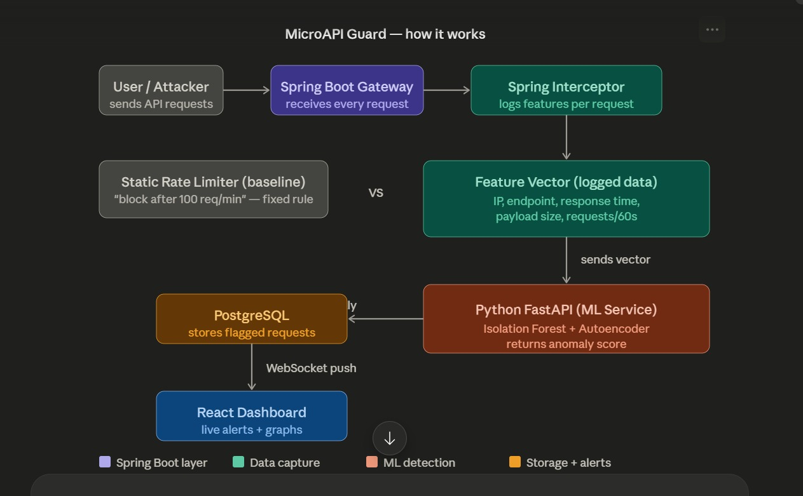
Proposed System Architecture
Flow: Client Request → Spring Boot Gateway → Interceptor (feature extraction) → Feature Vector → FastAPI ML Service (IF + AE + Static) → Anomaly Score → PostgreSQL + React Dashboard (WebSocket alerts)

Slide 9
Feature Set — Per Request
Feature | Type | Why It Matters
timestamp | DateTime | Detect time-of-day patterns (3 AM attacks)
endpoint | Category | Which API is targeted (/login vs /jobs)
HTTP method | Category | Unusual DELETE/PUT spikes
source_ip | Category | Per-IP behavior tracking
response_time_ms | Numeric | Latency spike = possible issue
payload_size_bytes | Numeric | Large payloads = possible attack
status_code | Numeric | 4xx/5xx spikes = problems
requests_in_last_60s | Numeric | Rolling window rate per IP
user_id | Category | Authenticated user tracking

Slide 10
Model 1: Isolation Forest
Type: Unsupervised, Tree-based | Library: scikit-learn
Core Idea: "Anomalies are FEW and DIFFERENT — easy to isolate"
How It Works:
Builds random decision trees with random splits
Normal points need MANY splits (in crowd)
Anomaly points need FEW splits (isolated early)
Short average path length = High anomaly score
Key Parameter: contamination = 0.05
Advantages:
Fast inference (milliseconds)
CPU-only — no GPU needed
Interpretable anomaly scores
No labeled data required

Slide 11
Model 2: Autoencoder
Type: Unsupervised Deep Learning | Library: TensorFlow/Keras
Core Idea: "Train on NORMAL data — high reconstruction error = anomaly"
Architecture:
Input(9) → Dense(16, ReLU) → Dense(8, ReLU) → Dense(16, ReLU) → Output(9, Sigmoid)
Encoder → Bottleneck(8) → Decoder
Anomaly Detection:
Trained ONLY on normal traffic data
Normal input → low reconstruction error
Anomaly input → HIGH reconstruction error → FLAGGED
Advantages:
Captures non-linear patterns
Works with complex feature relationships
CPU-trainable for our data scale

Slide 12
Model 3: Static Threshold
Type: Traditional Rule-Based | Implementation: Java in Spring Boot
Purpose: Acts as CONTROL GROUP for fair comparison. Represents the "existing system" / industry standard. Our hypothesis: ML models will outperform this baseline.
Example Rules:
/login: max 10 requests/min per IP
/api/jobs: max 50 requests/min per IP
Global: max 100 requests/min per IP
Known Limitations:
High false positive rate (~18%)
Smart attackers bypass by staying under limit
Cannot adapt to changing traffic patterns
Blocks legitimate traffic spikes
No learning, no adaptation — same rule for all users

Slide 13
Implementation Plan (12 Weeks)
Phase | Duration | Tasks
Phase 1 | Week 1-3 | Set up Spring Boot API surface Build logging interceptor Create traffic generator script Feature engineering & data collection
Phase 2 | Week 4-7 | Train Isolation Forest model Train Autoencoder model Implement static threshold baseline Tune hyperparameters
Phase 3 | Week 8-10 | Build FastAPI ML microservice Integrate with Spring Boot Build React dashboard WebSocket real-time alerts
Phase 4 | Week 11-12 | Run all 3 models on same dataset Calculate evaluation metrics Write IEEE research paper Final testing & documentation

Slide 14
Evaluation Metrics
All 3 models will be evaluated on the SAME dataset for fair comparison.
Metric | What It Measures
Precision | Of all flagged requests, how many were actually attacks?
Recall | Of all actual attacks, how many were correctly caught?
F1-Score | Harmonic mean of Precision & Recall (balanced measure)
False Positive Rate | How many legitimate requests were wrongly flagged as attacks?
Detection Latency | Time taken to flag an attack (ms) — critical for real-time systems

Slide 15
Expected Results (Hypothesis)
Model | Precision | Recall | FPR | Speed
Static Threshold | ~75% | ~70% | ~18% | Fast
Isolation Forest | ~90% | ~88% | ~4% | Fast
Autoencoder | ~92% | ~90% | ~3% | Medium
⚠ These are HYPOTHESIZED values based on literature review. Actual results measured during Phase 4.
Key Hypotheses:
ML models will significantly outperform static threshold
Autoencoder may have slightly better precision (non-linear patterns)
Isolation Forest will have fastest inference time

Slide 16
Technology Stack
Layer | Technology | Purpose
API Gateway | Spring Boot 3 | Host APIs + interceptor
Traffic Logging | Spring Interceptor | Capture every request
Traffic Simulation | Python / Locust | Normal + attack traffic generation
ML Models | scikit-learn, TensorFlow/Keras | Isolation Forest + Autoencoder
ML Microservice | FastAPI (Python) | Serve ML predictions
Real-time Alerts | WebSockets | Live dashboard push
Frontend | React.js | Dashboard + graphs
Database | PostgreSQL | Store logs + anomalies
Deployment | Docker | Containerization

Slide 17
Team Roles & Responsibilities
Member | Responsibility
Person A | Spring Boot interceptor / logging setup Traffic generator script (Locust/Python) Spring Boot ↔ FastAPI integration Database schema & data pipeline
Person B | Isolation Forest model training & tuning Autoencoder model training & tuning Static threshold implementation Evaluation metrics & comparison study
Person C | React dashboard development WebSocket real-time alert integration IEEE research paper writing & formatting Documentation & presentation

Slide 18
Conclusion & Future Scope
Conclusion:
MicroAPI Guard provides an intelligent, adaptive alternative to static rate limiting for API security
3-way comparison (IF vs AE vs Static) addresses a clear gap in existing literature
Lightweight architecture — deployable without Kafka/Flink
Real-time detection with WebSocket live alerting
Future Scope:
LSTM integration for sequential pattern detection
Feedback loop — learn from confirmed false positives
Concept drift handling — automatic model retraining
Multi-cluster deployment for distributed microservices
Explainable AI (XAI) integration for alert reasoning
Zero-Trust architecture alignment

Slide 19
References
[1] Liu et al., "Isolation-based anomaly detection," ACM TKDD, 2012/2020.
[2] Ahmed & Khan, "Unsupervised anomaly detection in REST API logs using isolation forest," IEEE Access, 2021.
[3] Zhang & Wang, "Autoencoder-based intrusion detection for HTTP traffic," IEEE Trans. IFS, 2022.
[4] Kumar & Reddy, "Feature engineering for API anomaly detection — a survey," 2022.
[5] Patel & Sharma, "Rate limiting vs ML-based detection in microservices," IEEE IoT Journal, 2023.
[6] Sowmya M. et al., "API traffic anomaly detection in microservice architecture," IEEE/ACM CCGridW, 2023.
[7] "CNN-Autoencoder hybrid for anomaly classification," 2024.
[8] "GCN-LSTM-Autoencoder for temporal anomaly detection," ETASR, 2024.
[9] "Optimizing autoencoders for network anomaly detection," IEEE IJCNN, 2024.
[10] "ML models for anomaly detection in microservices," 2024.
[11] "Adaptive API gateway with reinforcement learning," IJSRA, 2024.
[12] "Preference isolation forest for high-dimensional spaces," arXiv, 2025.
[13] "AI-driven real-time log anomaly detection," 2025.
[14] Bagade et al., "ObserveX: Real-time API observability & anomaly detection," IJSDR, Nov 2025.
[15] "Multi-level ensemble anomaly detection for microservices," 2026.

